Slide 1
Introduction
IN721 2017
Design and Development for Mobile Devices
Session 1.1

Slide 2
Administration
Name | Patricia Haden
Role | Principal Lecturer
Location | D308
Phone | 474-2854
email | Patricia.Haden@op.ac.nz
Notes:
I am often online evenings (except Sunday and Wednesday) and weekends, so if you need help, email me.
I am not available Sunday mornings.

Slide 3
Administration
Session 1 | Session 2
W 3-5 D207 | F 10-12 D207
Notes:
For the first weeks of the paper I will be requiring you to do any in-class practical work actually in class (as opposed to in the Project Room or at home). This allows me to observe any early problems that need to be addressed. So please make sure that your schedule allows you to remain for the entire time for both sessions.

Slide 4
Thinking about Third Year
How are 3rd year papers different?
Who can actually get a job as a software dev?
Notes:
More independent
In second year, we specify the target, and tell you how to get there. In third year, sometimes we just specify the target, and you have to figure out how to get there by yourself. This is to prepare you for the job, where pretty much nobody ever tells you anything but what you’re supposed to deliver.
More flexible
As much as possible I want you to be able to make things you care about. Therefore, assignments will generally be designed to give you a lot of latitude. You get general specs or FR, but you can often hit them in a personalised way
More work
At 3rd year you are expected to spend twice as many hours outside of class as there are scheduled teaching hours. That is, in addition to the 4 hours a week you spend in class, you are expected to spend a minimum of 8 additional hours working on your own. The practicals and assignments assume this much commitment, so be sure to schedule it in.
And absolutely do not fall behind. This is a “scaffolded” paper. That means that topic n builds on, and assumes mastery of, topic n-1. If you fall substantially behind, you will probably not be able to catch up. If it is unavoidable, due to health or family issues, see me VERY PROMPTLY.
Remember, this is 3rd year – there are no convenient do-overs.
More fun
Because of the above.
Getting a job: Natural ability * how hard you work * not being a jerk

Slide 5
Content
Development of Mobile Applications
Android
Java
Design of Mobile Applications (HCI)
Design for general usability
Human perception and cognition
Specific issues in mobile – UI and UX
Notes:
We are using Android because the software is open source, the community is large, it is easier to deploy than iOS and has a bigger market share than Windows.
Remember that, as always, it’s not about the particular tool or language or environment, it is about the underlying principles, that you want to learn well enough to generalise to whatever tool/language/environment you need.
We will be coding in Java, but the libraries and architectures are very Android-specific.
If you learned everything in C++, you should l be fine in this paper. If you didn’t take C++ or you didn’t learn everything in there, please schedule in some extra time in the first few weeks to get your coding skills up to speed.
We are not referring here solely to look and feel, but to broader issues of usability and user experience.
The design of mobile applications is complex and interesting, and introduces some new issues to the general principles of HCI.
To address this, however, we must first start with those general principles, which we will do, before addressing the particular concerns of mobile.

Slide 6
Provisional Schedule
Week | Session 1 | Session 2
1 | Introduction to Android Studio | First Code – resources and controls
2 | Event handlers | Universal Design Principles
3 | More screen controls | Basic Activities and Intents
4 | Navigation Options | Fragments 1
5 | Data Passing | Fragments 2
6 | Visual and Auditory systems | Perception practical
7 | Custom Controls | Issues in Mobile Screen Design
8 | Data storage 1 | Data storage 2
9 | Onboard hardware 1 | Good Friday – no class
10 | Onboard hardware 2 | 3rd Party APIs and libraries 1
11 | 3rd Party APIs and libraries 2 | Location-based services 1
12 | Location-based services 2 | Project spec
13 | Project work | Project work
14 | User testing | User testing
15 | Project work | Project work
16 | Exam prep | Exam
Notes:
Absolutely, positively subject to change.

Slide 7
Assessments
Component | Weight | Comments
In-class practicals | 20% | Due dates will be strictly enforced Submission via GitBucket repo only (see handout)
Project | 50% | Three parts: Beta version User testing and consequent modifications Final release Marks based on design and code quality and functional robustness
Exam | 30% | All course material presented in class and/or covered in the readings is examinable.
Notes:
Complete details as they arise
Note the stricter requirements for 3rd year.
First couple of weeks we will mark in class; later I will be looking at your GitHub page
Project will be “choose from these options”. You’ll do requirements elicitation, design and implementation. Probably in pairs/
Note the user testing. This is a very technical process and is a requirement for the majority of 3rd year projects, so we’ll do it thoroughly in this paper.
Readings assigned as they come up.

Slide 8
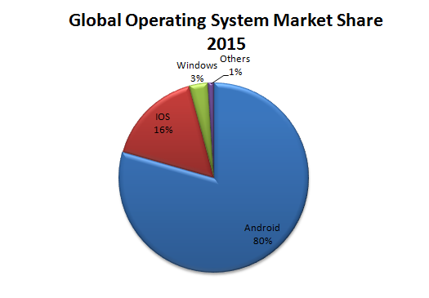

Introduction to Android
Notes:
The Mascot
And the market share. These values differ depending on source (can you think why that would be)? But Android always has the biggest slice of pie.

Slide 9
The Android Platform
An end-to-end mobile application development and execution platform.
Initiated in 2007 by the Open Handset Alliance
Open source and non-proprietary
Development
Java with Android libraries
Until 2014, Eclipse using Android plug-ins.
Android Studio.
Notes:
An end-to-end mobile application development and execution platform.
Not unreasonable to think of it as both the development tools, the execution environment and the operating system. So sort of like Visual Studio + the .NET framework + Windows, but only for mobile devices.
Initiated in 2007 by the Open Handset Alliance
OHA a group of hardware manufacturers, telecoms companies and software developers (including, of course, Google).
OS
Based on Linux
Makes it a feisty competitor to Apple and Blackberry’s proprietary tools
Development
We will use AS throughout, but you should be aware of the Eclipse option, and note that lots of extant resource materials are based on Eclipse. The difference between the two is just the IDE (and file structure), not the code, so you should be able to get value out of these older materials.

Slide 10
The Android Computational Model
Multiple apps run simultaneously, each in its own “security sandbox”.
“..each app, by default, has access only to the components that it requires to do its work and no more.” - developer.android.com
Apps communicate via messaging, allowing them to share data and services.
Notes:
Essentially, each app running on your phone is running inside its own virtual machine.

Slide 11
Android Computational Entities
Activity
The classic “app” is composed of multiple Activities.
A single screen with associated interface definition and computation.
Can communicate with other Activities (including those in other applications) via messaging.
All activities descend from android.app.Activity
Notes:
Activity
This is how the normal sort of app we think of as “things that run on your phone not in the browser” is built.
Activities are computational entities – specifically, instances of a class defined in the Android libraries.
Interface definition: Think of it like the HTML that defines a web page, or the “designer.cs” part of a C# application that declares all the screen controls and their properties.
So if you have a game on your phone that has a splash screen, settings, high scores and the actual play, it probably has four separate Activities.
We will look at the messaging model in detail as we go along.
Android programming is just Java programming using the Android classes. The way Visual C++ programming is just C++ programming using the .NET classes. So the bulk of the learning will be in getting to know those classes and how to use them.
They will seem pretty weird at first, so think always about why the designers built them this way.

Slide 12
Android Computational Entities
Service
Has no interface.
Runs in the background and performs work for other components (e.g. Activities).
Content Provider
Data manager
Exposes a standard API for other computational elements to access the data.
Broadcast Receiver
System-wide listener
Notes:
There are also these other ones.
We will see them as we go along, but when people think about “building an app” they are thinking primarily about working with instances of the Activity class.
Service
E.G. Database pipeline, audio driver
Content provider
E.g. There is a content provider that manages your contacts. It can be queried by any app running on the phone.
Broadcast receiver
Lurks around listening for system-wide events (e.g. Turning off the phone) and routes consequent messages.

Slide 13
Android Computational Communication
Activities, Services, Content Providers and Broadcast Receivers are highly interactive.
Any app can ask to transfer control to any other app’s components (directly or indirectly).
Apps register the work they can do.
When work of a given type is requested, the system looks dynamically for some entity that can do it.
This communication performed via Intent objects
Notes:
Directly:
“Start Bob.methodName”
Indirectly:
“Start somebody who can get me the GPS reading”
This messaging behaviour is very interesting, and is one of the things that most distinguishes Android from other operating systems.
It provides a lot of efficiency, because you don’t have to be always writing your own code and running your own processing threads, if there is someone out there already who can do it for you.
Intent objects are just another Android class. They manage the information that the system needs to get all this inter-application communication going. We will look at them in lots of detail later on.
So, there’s a lot of high level stuff going on in the Android system. But for the developer, it starts with creating your own apps, and those apps consist of one or more Activity instances, or simple “activities”.
Very shortly, we will see how to do that in Android Studio. First, though, we need to see how an activity behaves...

Slide 14
The Activity Lifecycle
Activities are event driven.
We will write code for events in the Activity Lifecycle.
Notes:
This should be quite familiar.
You have written code for OnClick events and Form_Load events, right?

Slide 15
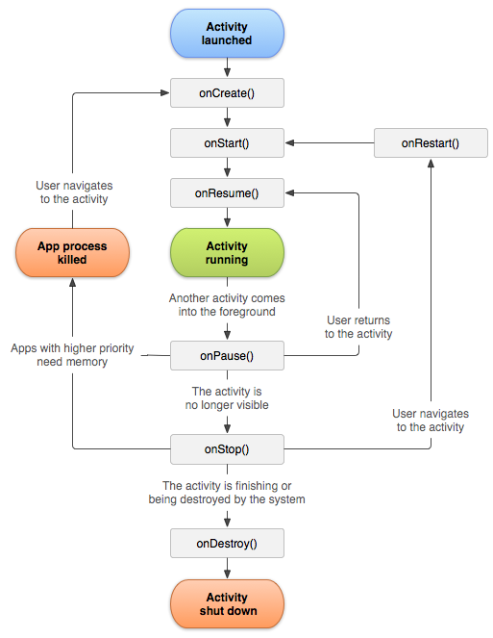
The Activity Lifecycle
Notes:
From android.com
This should be quite familiar.
You have written code for OnClick events and Form_Load events, right? As in those cases, it’s all about figuring out where to put what.
These events are not all of equal importance. Some happen every time an app is used, others happen only in special unusual situations. In the first instance, we will be concentrating on coding the most important events (e.g. “when the app starts”), and will look at the more special purpose ones as we go.
Briefly, these are the elements of the life cycle:
onCreate:
Called when the activity is first created. Before it appears on the screen.
onStart:
Called when the activity gets the screen.
onRestart:
Called if you’ve been stopped, and now are getting control back. Always followed by onStart
onResume:
Called when the activity is in the foreground accepting user input. Happens if you have been backgrounded (paused) and are now being foregrounded. All called somewhat trivially after onStart.
onPause:
You’ve been backgrounded, but not killed. However, if memory gets tight, you can get killed. If that happens, when the user foregrounds you, you have to be recreated. Think about the implications of this for what code goes in the onCreate and onPause handlers.
onStop:
You lose your screen handle. You are about to be killed. Not always called, if you get killed from the pause state.
onDestroy:
You’re losing your memory. This may be voluntary because you are shutting down, or involuntary because the system is freeing up memory.
To get started, we’re going to worry mostly about onCreate. But in more advanced scenarios, you would want to think about all the necessary initialisation, reinitialisation, clean-up, data saving, etc., that you require, and where it needs to go.

Slide 16
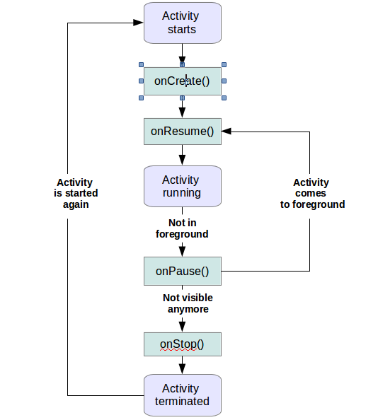
Simplified Activity Lifecycle
Notes:
From vogella.com
Many people find this version clearer, as it highlights only those events you are really likely to want to write code for.
This site, written by Lars Vogel (author of Eclipse), has lots of good Android stuff on it.
As always, be choosy about your online resources. There is a lot of stuff out there that is badly done and lots that is simply wrong.
Also as always, avoid stackOverflow for basics. Much better to use the official documentation or a professional written and edited textbook.

Slide 17
Android Studio
Code editor
Screen designer
Compiler
Debugger
Build tool
Emulator
Notes:
IDE for Android app development. Supported and maintained by Google.
Provides these elements (and a bunch of other stuff we will look at if we have time, like testing framework, diagnostics, etc.)

Slide 18
Android Studio
Should be installed on all OP machines
For laptop installation go to
http://developer.android.com/studio/index.html
Notes:
Laptop users: The install bundle brings down a basic configuration. At first execution there will probably be updates, and you will probably need to install additional packages along the way.
(When you first start it up, AS will prompt you for any updates it wants – it is best to let it have anything it asks for.)
AS is set up to handle this nicely (why do you think that is?) and we will look at how it is done here in class.

Slide 19
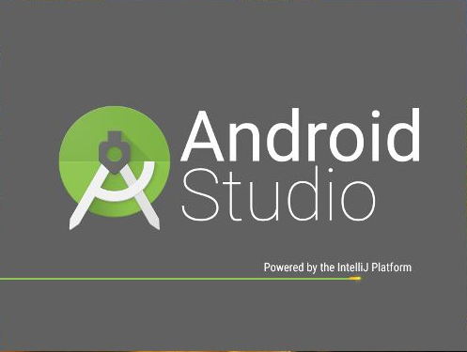
Android Studio
Notes:
FYI: IntelliJ is a platform for building IDEs. Sort of an IDE for creating IDEs.
Abstraction driven evolution of software has produced tools for everything. This facilitates development and is cool. But keep in mind that there are the people who use the tools, and the people who build the tools. If you want to be able to build the tools, you need to think deeply about the deep logical structure of software – algorithms, data structures, etc. (You have to do this while you are using the tools, of course.)
We’re going to look at some quick screenshots here, then you will have a practical. Please do not work along – it is more important that you listen. There are some small quirks that I’m going to tell you about now, and it’s going to by quickly. If you are clicking on things and paying attention to your screen, you will miss these comments and waste a lot of time.
Laptops can be closed now if necessary.

Slide 20
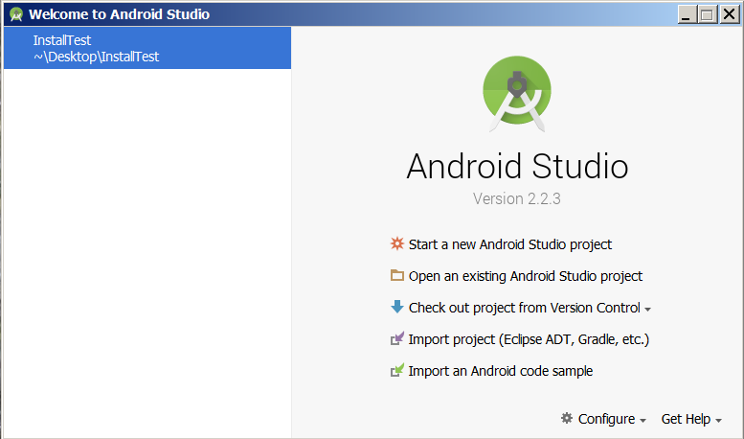
Creating a Project
Notes:
AS 2.2.3
When you first launch AS, you will either see it open to the most recently opened project, or to this wizard window (depending on the state of the machine and the configuration of AS on that machine).
We will want this wizard today to walk us through creation of our first project.
Android apps have an extremely complex and idiosyncratic file structure. You don’t set them up by hand, you let AS do it.
Since we share machines here, if you launch AS and see some Project you don’t want, just select File->Close Project to get to the wizard.
What you see in the Recent Projects sidebar will, of course, vary.
To get started, you will click on “Start a new Android Studio project” ...

Slide 21
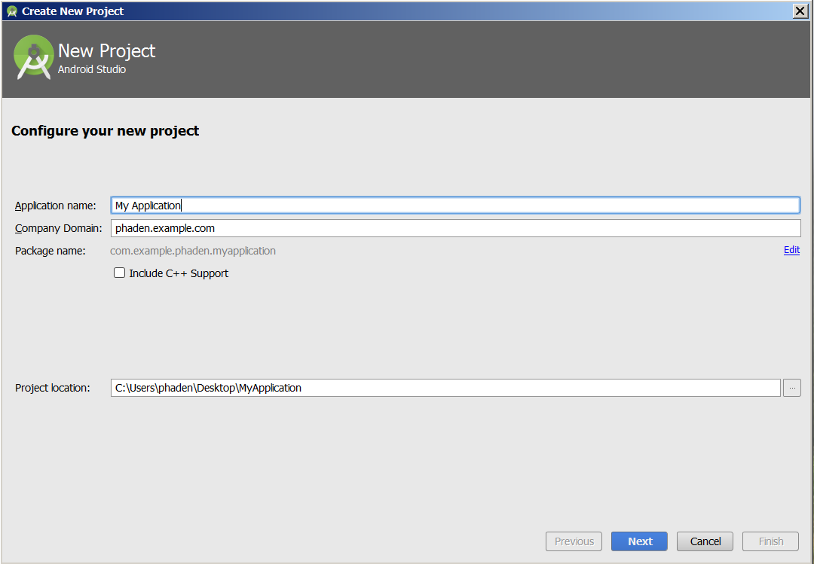
Creating a Project
Notes:
You will get these defaults
YOU MUST CHANGE SOME OF THEM
See next slide

Slide 22
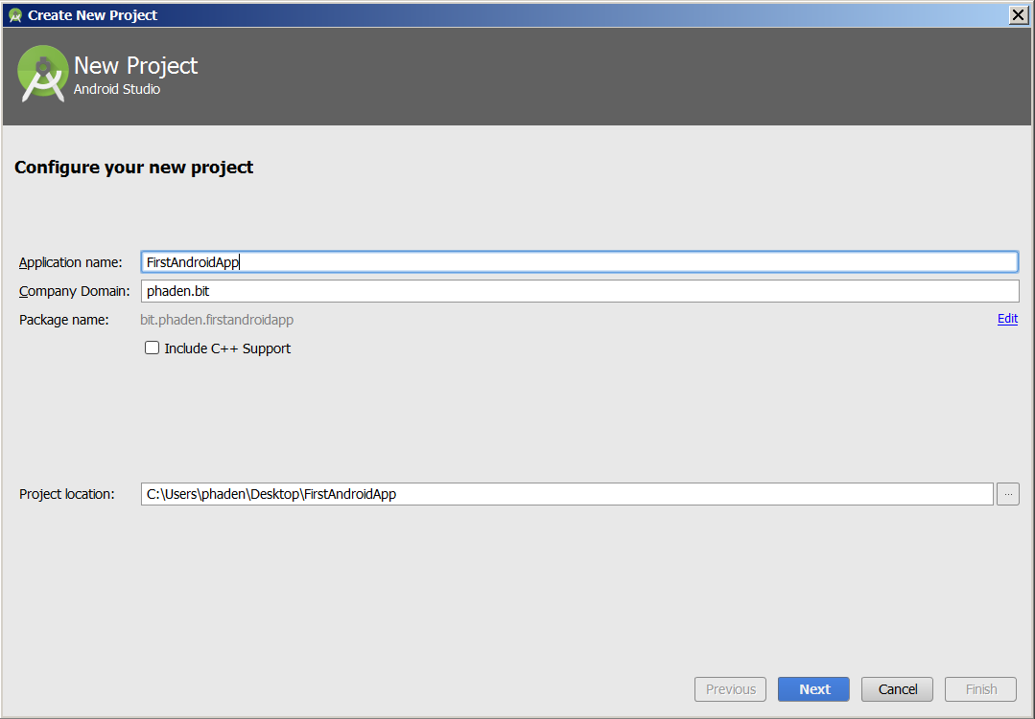
Creating a Project
Notes:
Name all apps something descriptive. DO NOT name your apps “PracX.y”. This is not meaningful. A couple of weeks from now, neither you nor I will be able to remember what Prac3.2 was. No marks will be given for anything called PracX.Y.
Android apps use the standard Java “reverse package naming” protocol. In tutorials you will often see example.companyname.com become com.companyname.example. We will use yourOPUserName.bit as the “Company Domain” for everything you make in this paper. The package will then be bit.yourOPUserName.AppName (all lower case, following Java convention). No marks will be given for projects which violate this protocol (I use it to keep my archives organised).
This will vary depending on where you are. Presumably you will be getting all your course work onto git and github, so moving from machine to machine will not be dangerous.

Slide 23
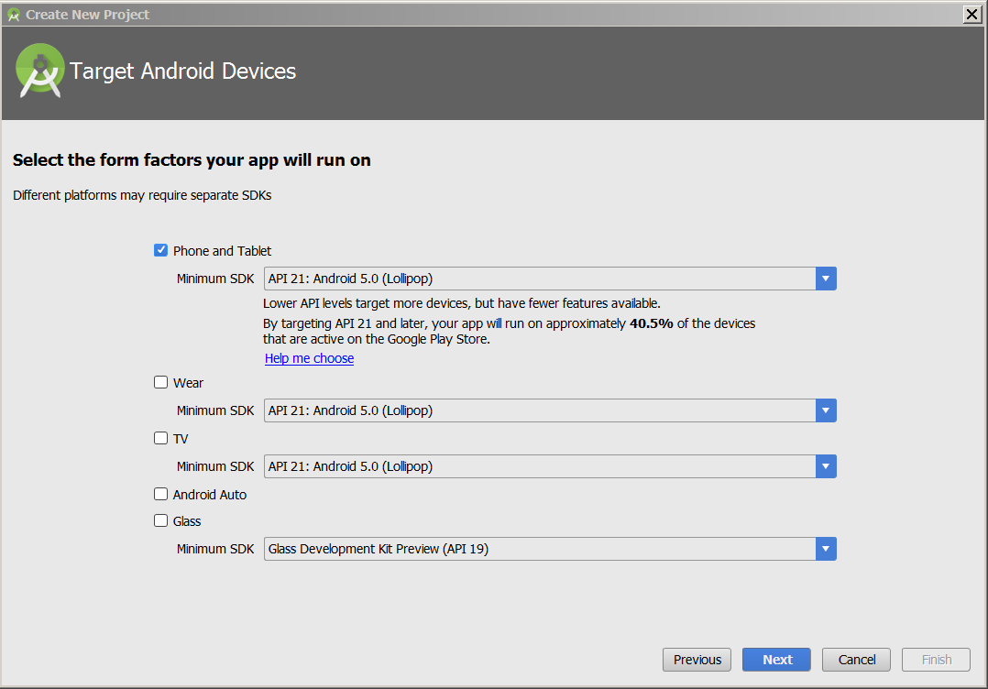
Creating a Project
Notes:
You will then be asked to select the form factors (i.e. Phone, wearable, TV) and SDK versions you want your app to run on.
AS uses this information to select versions of the Android libraries when compiling and building.
Form factor is easy: For now (and probably for the whole paper) we will be using Phone and Tablet, but you may use some of the others for Project.
SDK is more complex.
When you write C# code, you use, say, .NET 4.5. And that’s it. People who want to run your code have to have the .NET 4.5 runtime environment.
Android is more flexible.
Google and the Alliance release new versions of the Android operating system, and new versions of the Android class libraries about every 20 minutes. This is the modern software development style.
A given phone or tablet, however, will be limited to a small range of versions because of its hardware. For example, the official current version of Android is 7.x. But my phone, purchased only about two years ago, can’t support anything past 4.x.
How then do you build an app that real people with real phones will be able to run?
When you create a new project, AS will offer you the latest version of the Android libraries that it has installed (for the OP machines this is API 25).
It will also ask you how far back you want to grandfather. This is your Minimum SDK. When it compiles and builds, it will alert you to any parts of your code that are not backwards compatible to the Minimum SDK, and you can decide how to cope with that (there are various options that we will see later in the paper).
For greatest flexibility, you want to set your Minimum SDK to API 15 (IceCreamSandwich). Between JellyBean and IceCreamSandwich there was a large, qualitative evolution in Android. Since then, not so much (it’s mostly been adding new features like fingerprint recognition, smarter location services, etc.) . So it is pretty easy to maintain backward compatibility to API 15.
To get the bulk of the modern functionality, and still be accessible to a lot of devices, go to 21, the next fairly distinct break point. But understand that you will lost a lot of devices…
As you can see AS will tell you the approximate proportion of real purchased devices that will be able to run your app for a chosen Minimum SDK.
At 21, it is 40.5%; at 15 it is 97.4%
In this class, you must target at least 21 so I can run your code on the older OP phones.

Slide 24
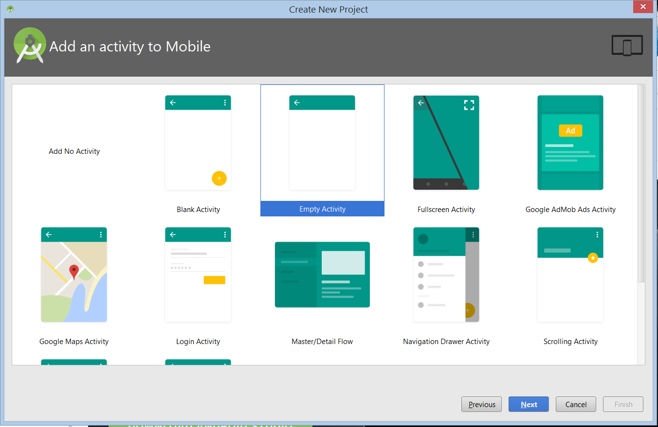
Creating a Project
Notes:
You will then be offered a selection of templates. These are quite useful, once you know what you are doing so that you can customise them as required.
But until then, we will start with an Empty Activity. Not a Basic Activity. This creates a Project with all the file structure in place, plus one instance of the Activity class (i.e. one app screen) with the minimum amount of code required to make a runnable program.

Slide 25
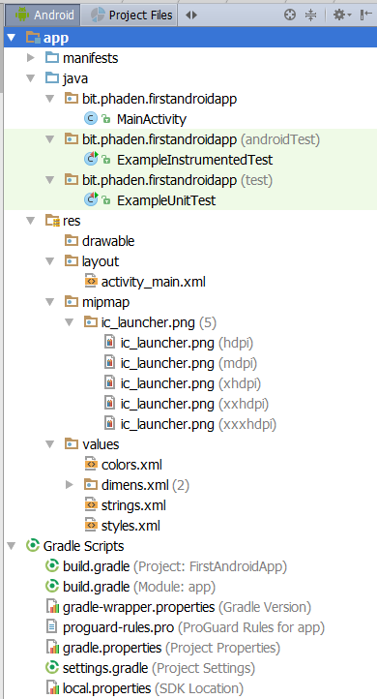
Creating a Project
File Structure
Notes:
You will see from the Explorer that your Project is created with a lot of folders and files. We will look at them all in detail as we proceed.
One thing to be aware of, to avoid confusion: the “file structure” you see in the Package Explorer and the actual arrangement of files in folders on disk are not the same.
The PE shows you an abstracted (logical) arrangement.
You can browse through the physical arrangement using the provided tabs, if you need to. (Later, we will encounter a reason that you might need to...)
To begin, however, stick with the PE, because it is more useful and clearer.

Slide 26
Before we can start….
An XML refresher

Slide 27
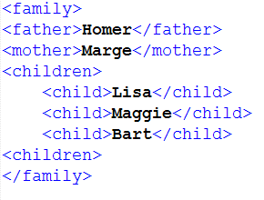
XML
Notes:
Like HTML, except you make up your own tags.
Allows representation of any hierarchical organisation
Use attributed to add extra bits of information.
For example.
Note that, unlike HTML, there is no “standard” for XML. You literally make up any tags you want.
As long as the nesting is correct (i.e. One outer tag to hold them all, outer elements completely enclose their inner elements, and every open tag has a close), it’s syntactically correct XML.
So, different people can choose to represent the same information in different ways.
For example, I can define a family this way. You might do it differently – siblings instead of children, a guardians element that contained mother and father, elements for aunts and uncles, etc.

Slide 28
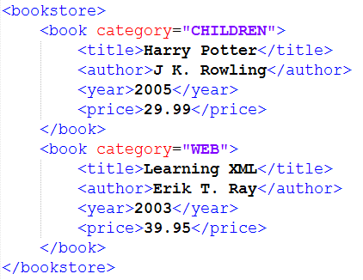
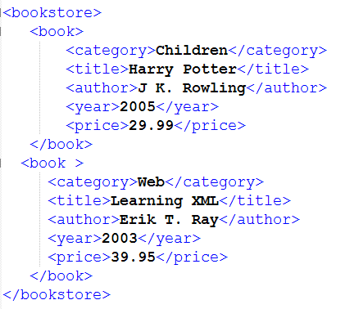
XML
Notes:
Here is another example:
Assume you want to represent the inventory of a bookstore in XML
Here is one way....
Here is an alternative, where category has been defined as a component element of <book>, not as an attribute.
Both are completely legal.
People using XML together must agree on what tags they want to use, who contains whom, and what goes in attributes and what goes in values.
As long as we are agreed on the rules, we can share information and write code to process that information.
Modern SDK’s will have built-in tools for parsing XML. So you can give it an XML text file as input and then ask for “all the child elements” or “the value of mother”, etc.
Here is what the XML for an Android screen layout looks like.

Slide 29
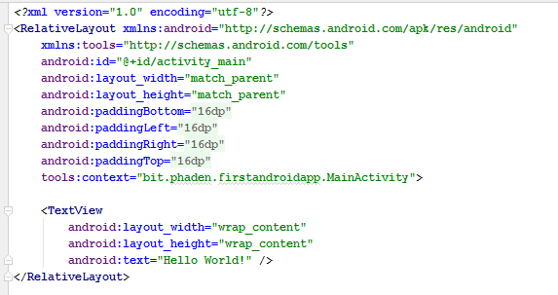
XML
Notes:
This file is /res/layout/activityName.xml
For the example app created in the Powerpoint, the XML is:
This is syntactically correct XML -- a <TextView> element (with a self-close tag), contained within a <RelativeLayout> element (with an explicit-close tag).
Note however, that, unlike many XML contexts, all of the information about these elements is expressed with attributes in the opening tag.
The <RelativeLayout> for example, contains 9 different attributes, all with lengthy value strings before its closing angle bracket (see the red arrow).
This is the Android/Eclipse way. Do we like it? No. It is ugly and hard to read. Will we learn to do it anyway? Yes.
We will look in detail at all these various tags, attributes and values as we go. For now, realise that everything you set in the Properties window in Graphical View will appear in this XML file as an attribute.
Note that the values of these attributes are, in some cases, expressed as android system constants (e.g. match_parent) and sometimes as strings that begin with @ and a file path. These latter strings are references to items that have been entered into one of the xml files in the /values folder of your app. For example, the string @dimen/activity_vertical_margin refers to an XML element of type <dimen> with name attribute "activity_vertical_margin" contained in the file /values/dimens.xml.

Slide 30
Practical 1.1
Create an Android Project with a single empty Activity
Modify some screen elements
Launch using the Android software device emulator
Notes:
Our primary goal today is to test the install and configuration of Android Studio on whatever machine you are using.
Be prepared: AS is very complex and not very mature, and it will be quirky, Weird problems will come up, and you will need to take the time to figure out how to solve them.
This is a perfectly normal part of the IT life. The more you do it, the better you will get at it.
There is a handout with all the details….

